Slide 1
ΤΗΕ PREPARATION OF ROASTING THE LAMB.

Slide 2
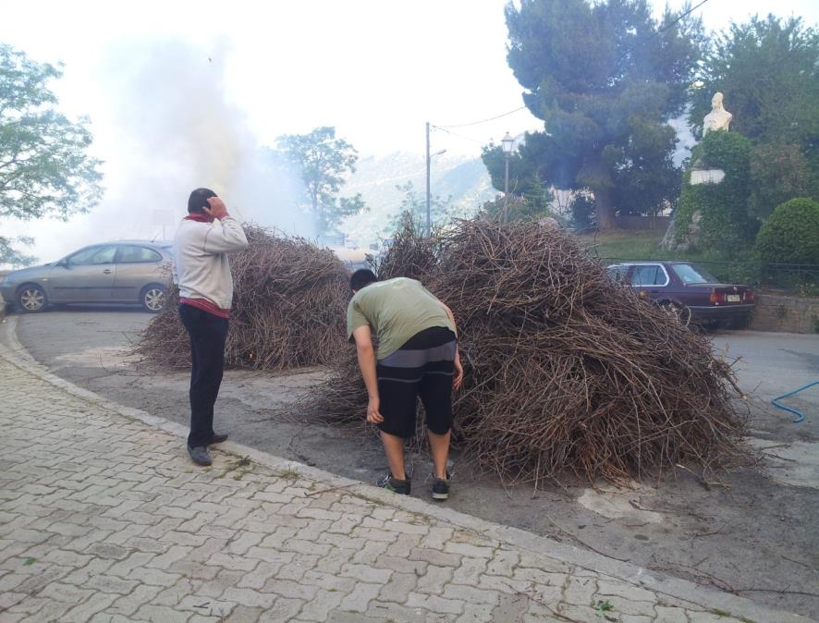

Slide 15
THE END

